Slide 1
Face detection with python using open CV
Project Guide: Team Members: M Praveen Kumar N Sai Joshna (168A1A0532) G Vyshnavi (168A1A0517) E Navya (168A1A0511) P Sravani (168A1A0536) G Ananth Nath (168A1A0551)

Slide 2
Contents
What is Face Detection
Importance of Face Detection
Simple Abstract
Technology
Hardware & Software
Modules
Old System & Proposed System
Result
Conclusion

Slide 3
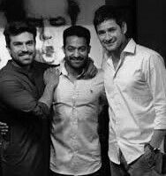
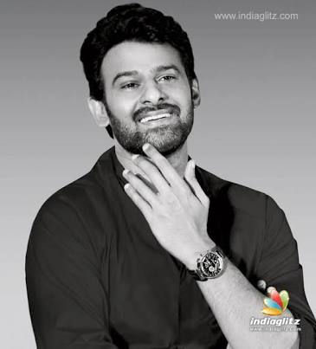
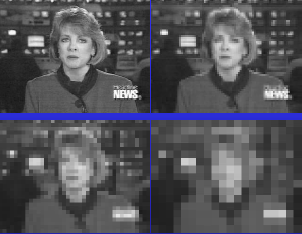


What is Face Detection?
Given an image, tell whether there is any human face, if there is, where is it(or where they are).
face detection refers to a subset of computer able to identify people's faces with the in the digital images.

Slide 4
Importance of Face Detection
The first step for any automatic face recognition system
First step in many Human Computer Interaction systems
Expression Recognition
Cognitive State/Emotional State Recogntion
First step in many surveillance systems
Tracking: Face is a highly non rigid object
A step towards Automatic Target Recognition(ATR) or generic object detection/recognition
Video coding……

Slide 5
Simple Abstract
Recently , we want to perform Face detection using Open CV in Python . Here the actual code is less than 50 lines of Python code, Thanks to the terse syntax of Python and now, we are sharing our requirements on this experiment, Here the front end which is designed by using xml code, it’s name as Harcascade frontal face default file, haarcascade_mcs_mouth, haarcascade mcs nose and haarc -ascade_eye we use Open CV libraries like cv2 file, it’s in the form of pyd format and majorly we use the platform is Python, it’s expecially 2.7 vertion only for these Opencv libraries are support on this only, it’s the facedetection which is start by using the web cam only here, it’s detect the face ,mouth,nose and eyes also by using this experiment we can detect the faces ,nose, eyes and mouth of humans.

Slide 6




Technology
Pyhton
Here, we use pyhton for main Activity
Open CV In the python code we use the Open CV libraries for detecter purpose
XML
The XML Harcascade codes are used in this project for the designing of the detecting process.
SQLiteStudio
The SQL tables are created in this Software for creating tables to store the database and connect the database for the output

Slide 7
Hardware & Software
Hardware
Processer : i3 core
RAM : 4 GB
Hard Disk : 1TB
Software
OS : Windows
Front end : XML
Back end : Python
DataBase: SQLiteStudio(3.2.1)

Slide 8
Modules
Switch on Web Camera
Face detecion
Mouth detection
Nose detection
Eyes detecion
Face Recognation

Slide 9
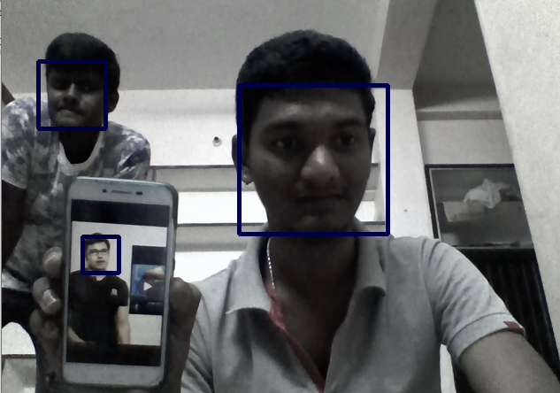
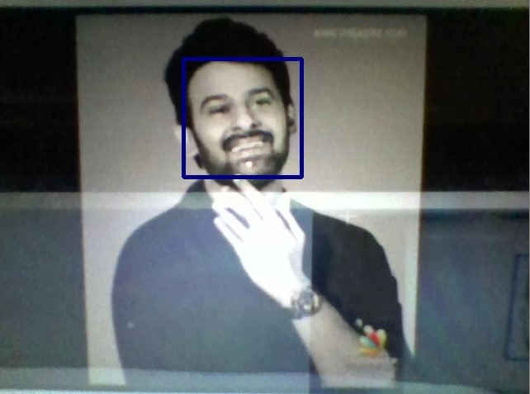
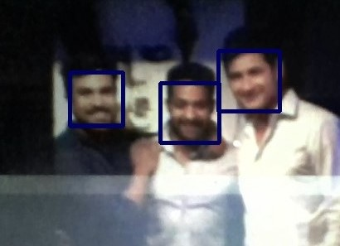
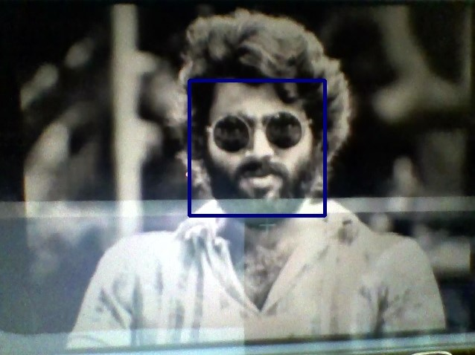
Old System
Now a days we observe the face
detection in number of technologies
like mobile camera,
Face book photo tagging
process and video
recorder etc.,

Slide 10
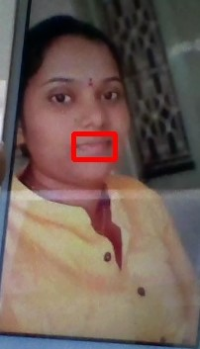
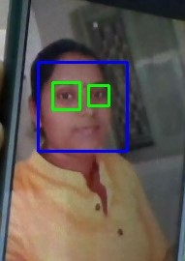
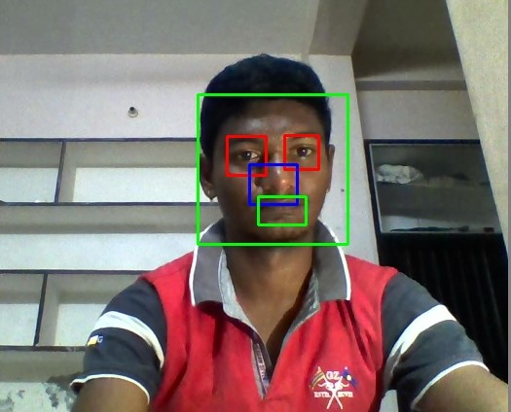
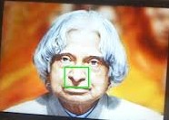
Proposed System
Our Proposed System is update of
The old system like we can detect
mouse, nose and eyes Step by step with
the face detection.
Here, we give a small example image
for that step by step detection process.

Slide 11
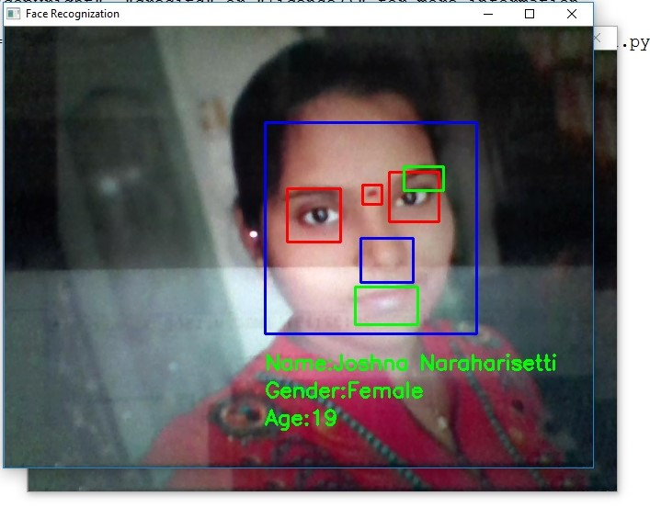
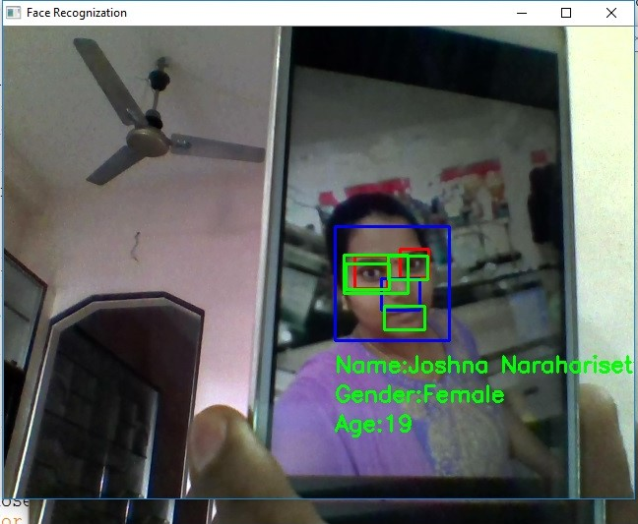
Results
Finally we got the output detection
image was given like this. In that
image detect the mouth, nose,
eyes and faces are in the single
frame

Slide 12
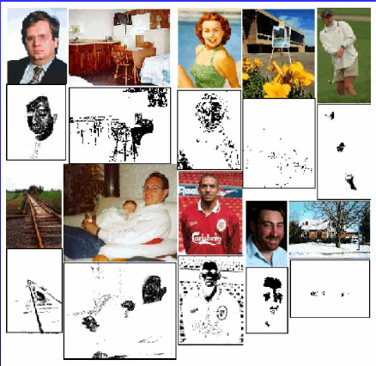
Color-Based Face Detector
Pros:
Easy to implement
Effective and efficient in constrained environment
Insensitive to pose, expression, rotation variation
Cons:
Sensitive to environment and lighting change
Noisy detection results (body parts, skin-tone line tone line regions)

Slide 13
Conclusion
Simple implementation of Open CV’s face Recognizer
Compare different training models here pose and lighting variations are there
By using this detection easy to Identify the faces
It‘s Future work of further testing of different training models
It’s implement to updating facial expressions.

Slide 14

Any Queries ?

Slide 15
Thank You

